Slide 1

Smart Identity Management Platform Layout
Brittany Jacques
Debolina Mukherjee
Glenn Kees
Jaime Barragan
Paul Rodriguez

Slide 2

Hypothesis
Identification of an individual or an asset is key for recognition. In today’s world, the most efficient way of having this record is in digital form. This project we hypothesizes that through smart identity powered by blockchain we can create a universal and secure technology for our users.

Slide 3

Motivation & Goal
Motivation behind this project was to establish a safe and dependable way to keep sensitive information stored on a blockchain. This was achieved by creating a smart contract that can store/change/remove any information that as deemed fit to build or a digital identity

Slide 4
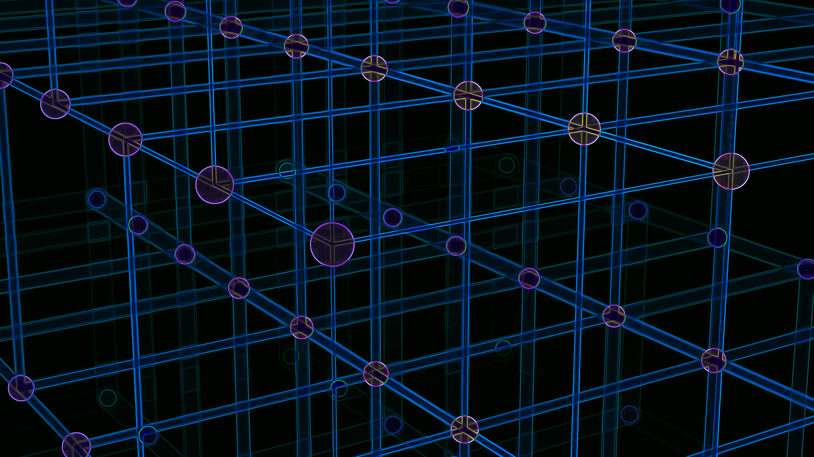
Summary
Front end UI developed through Jupyter Notebook and Streamlit
A non-fungible token was created using Solidity, which provided flexibility, security, and decentralization.
Web3 was leveraged through Python in order to communicate with Solidity

Slide 5

Data Exploration & Clean up

Slide 6

Results & Conclusions

Slide 7
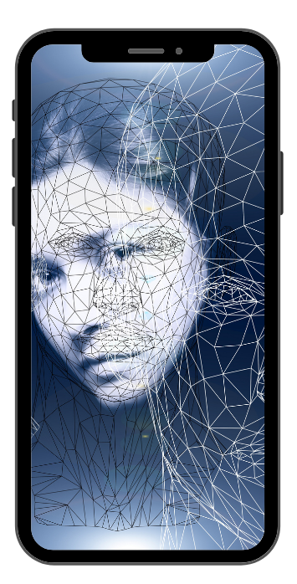

DEMO
Notes:
Glenn

Slide 8
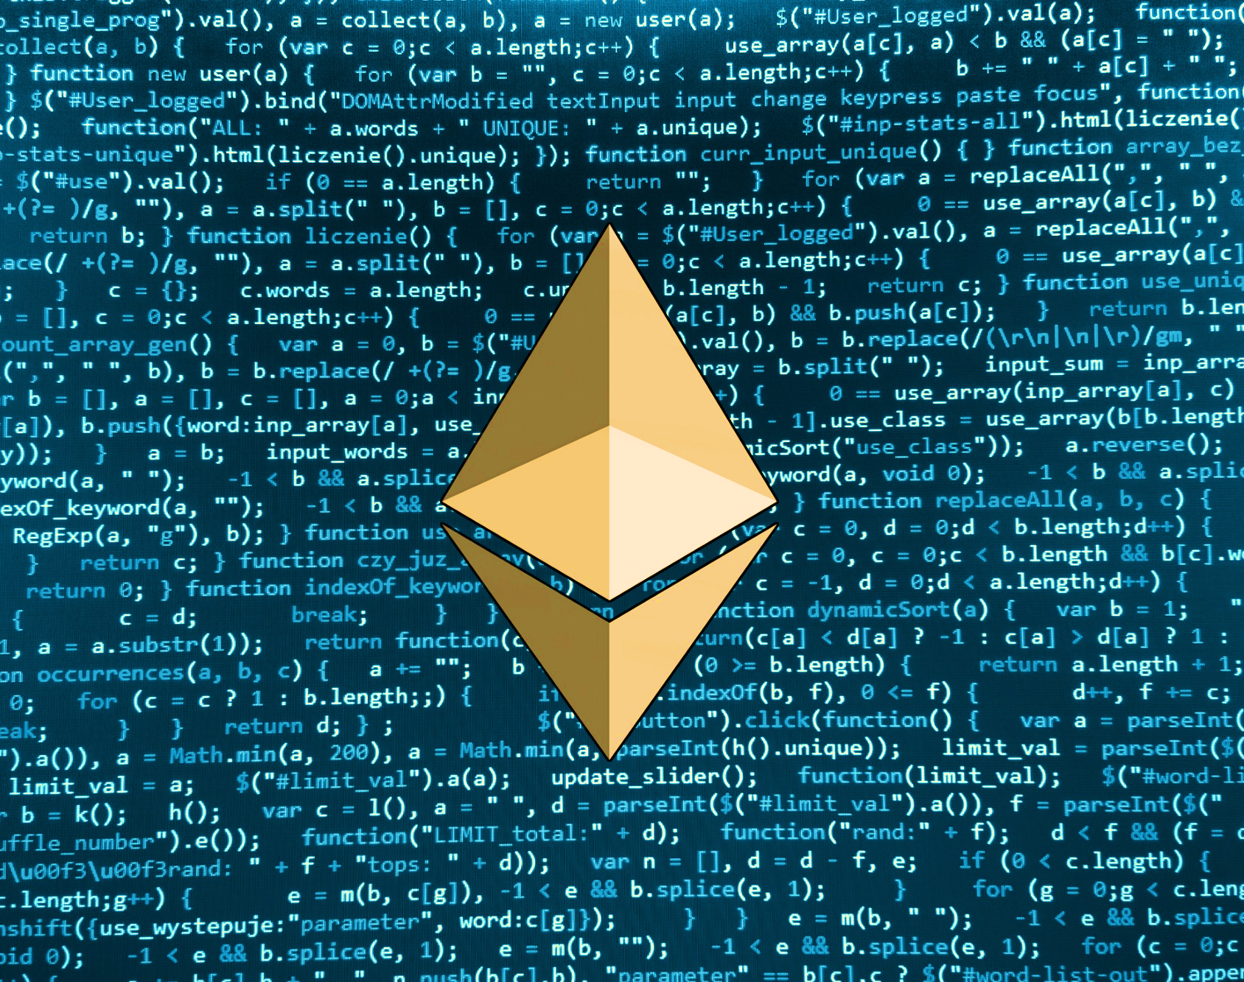
Next Steps
Authentication layer
ID Verification for ID scanning
Encryption
Payment gateway

Slide 9

Questions

